Slide 1
Mapping Tomorrow: Transforming Urban Infrastructure with OpenStreetMap Data
Niraj Bhagchandani - G23AI2087
Shubham Raj - G23AI2028
Bhavesh Arora - G23AI2126

Slide 2
Project Overview
Mapping Tomorrow: Transforming Urban Infrastructure with OpenStreetMap Data
Objective: Leveraging OpenStreetMap (OSM) data for smarter city planning.
Features:
Traffic heatmaps and congestion predictions.
Optimal route suggestions for emergency services.
Recommendations for expanding public transport.
Target Users: City planners and decision-makers

Slide 3
Challenges & Technological Approach
Title: Tackling Challenges with Technology
Key Challenges:
Managing large datasets from OSM.
Real-time processing of traffic and transport data.
Ensuring application scalability and performance.
Building an intuitive user interface.
Technological Solutions:
Backend: Node.js, Express.js, PostgreSQL with PostGIS, NodeDensity Histogram, Scatterplot, RoadLength Distribution, Node Density Heatmap, Node Orientation, Feature Type Frequency.
Frontend: React.js, Leaflet.js, Material-UI for UI and map visualization.
Cloud: AWS for scalability (EC2, S3, Kubernetes).
APIs: OpenStreetMap API for real-time data.

Slide 4
Data Exploration Workflow for planet_nodes Table
Schema Details:
Key fields included:
id: Unique identifier for each node.
latitude and longitude: Geographical coordinates.
geometry: Geospatial representation.
osm_timestamp: Timestamp of the last update.
all_tags: Metadata about the feature (e.g., amenity, highway).
Exploratory Data Analysis:
Key Visualized and analyzed the latitude and longitude data to understand spatial patterns.
Purpose of Analysis:
To derive actionable insights for urban planning and infrastructure optimization using node-level data.

Slide 5
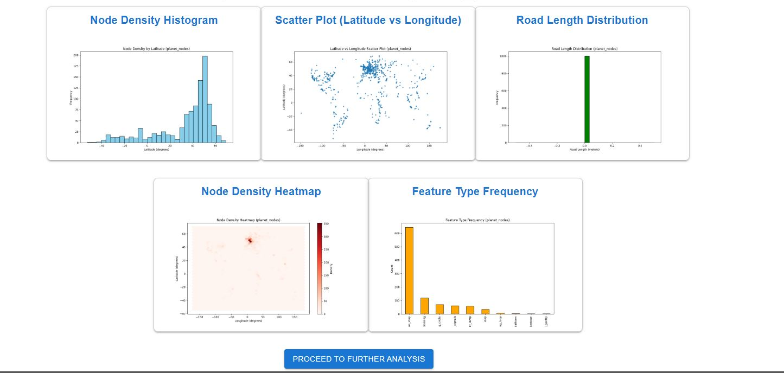
Exploratory Data Analysis of OpenStreetMap Data

Slide 6
Graphical Insights from OpenStreetMap Data
Node Density Histogram: Displays the frequency distribution of nodes by latitude, highlighting areas with high mapping activity.
Scatter Plot (Latitude vs Longitude): Visualizes the geographical spread of nodes, revealing dense urban clusters and sparse rural areas.
Road Length Distribution: Shows the distribution of road lengths, providing insights into the structure of road networks.
Node Density Heatmap: A heatmap that pinpoints regions with the highest node concentrations, indicating urban centers or areas with detailed mapping.
Feature Type Frequency: Analyzes the frequency of different feature types, such as highways or residential roads, to understand the predominant map elements.

Slide 7
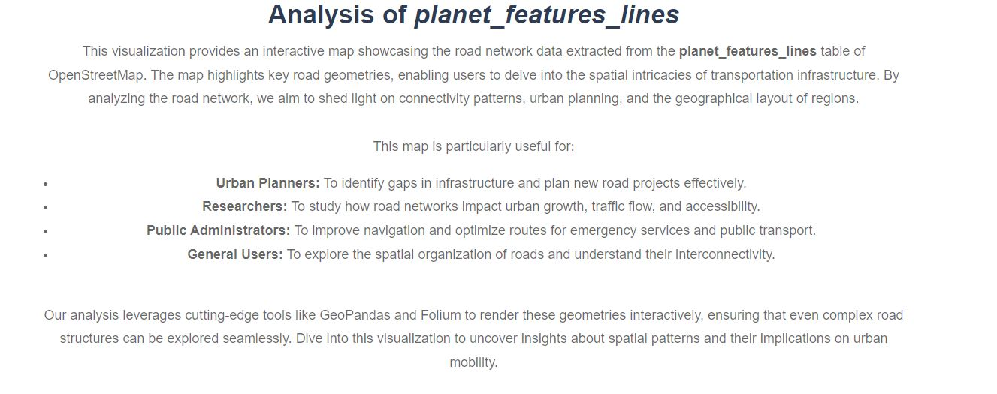

Slide 8
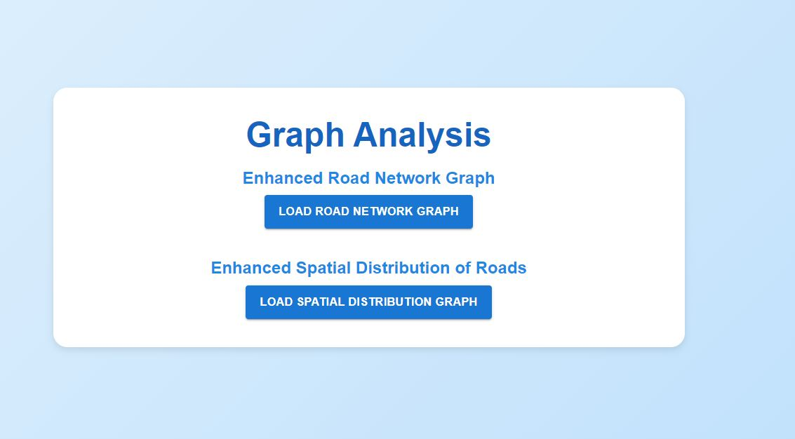
Graph Analysis

Slide 9
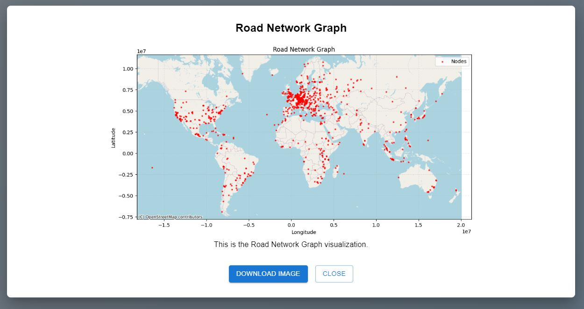
Exploration Road Network Graph for planet_nodes

Slide 10
Exploration Workflow for planet_nodes Table
Visualization Details:
Each red dot represents a node, which could be an intersection, point of interest, or part of the road network.
The map showcases the spatial layout of road networks worldwide using latitude and longitude.
Key Insights:
Dense clustering of nodes in regions like Europe, North America, and parts of Asia reflects high urbanization and detailed mapping.
Sparse node distribution in certain areas like deserts and oceans is expected due to less mapping activity or geographical constraints.
Use Cases:
Urban Planning: Identifying high-density areas to optimize traffic flow.
Mapping Accuracy: Highlighting regions with sparse node data for future mapping efforts.

Slide 11
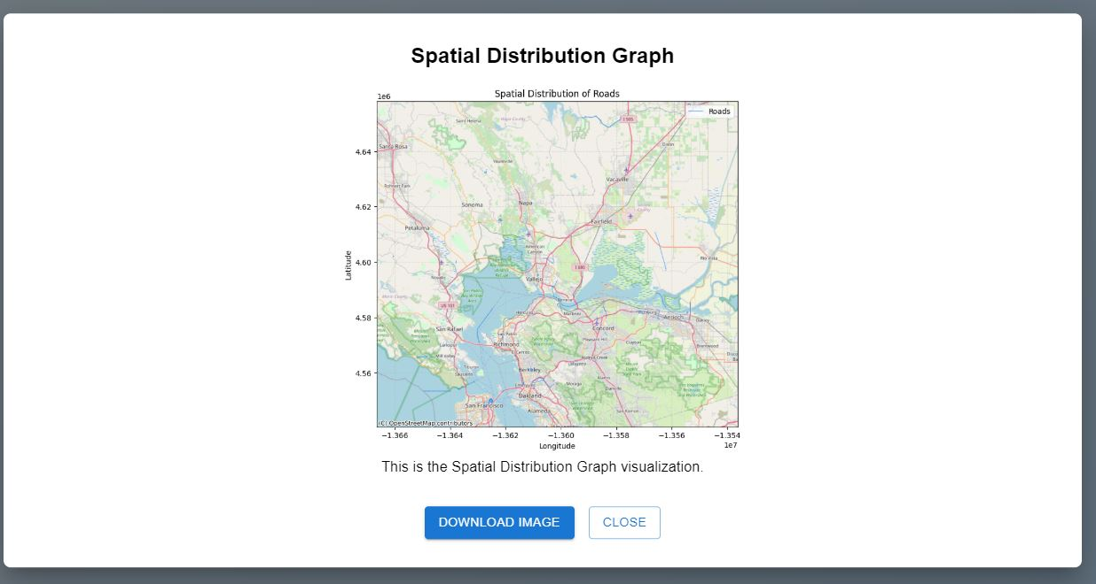
Mapping Road Networks: Spatial Analysis from planet_ways

Slide 12
Spatial Distribution of Roads from planet_ways table
Visualization Details:
The map shows roads as red lines plotted over a base map.
Roads are distributed spatially using Longitude and Latitude values from the planet_ways dataset.
Key Insights:
Highlights major road networks, intersections, and connectivity in the region.
Provides a detailed view of urban and rural road infrastructure.
Use Cases:
Infrastructure Planning: Helps city planners identify regions with dense or sparse road networks.
Traffic Analysis: Supports analysis of potential bottlenecks in the road layout.
Urban Development: Assists in optimizing future road construction.

Slide 13
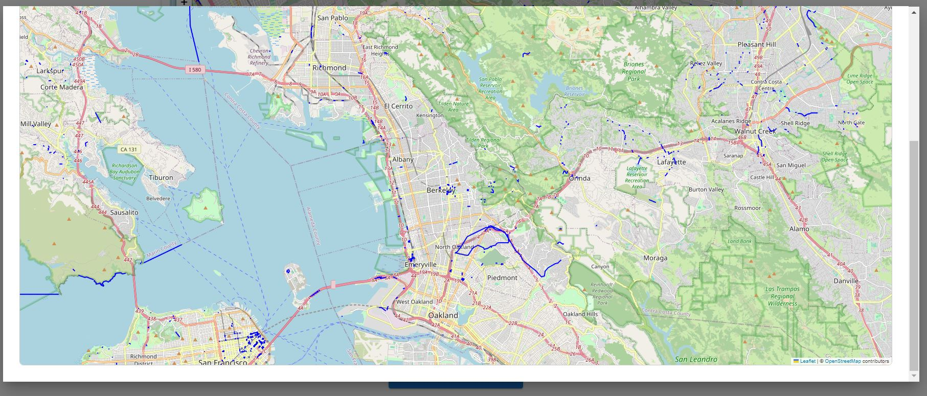
Spatial Distribution of Roads from planet_ways

Slide 14
Visualizing Key Features: Insights from planet_features table
Visualization Details:
The map overlays various geographic features, including roads (red lines), water bodies (blue), and green zones (parks or natural reserves).
Represents a highly detailed view of a specific region's infrastructure.
Key Insights:
The visualization helps identify connections between urban areas, natural reserves, and transport networks.
Highlights the spatial relationships between features, such as roads intersecting park boundaries or connecting urban centers.
Use Cases:
Environmental Planning: Identifying green zones and their interaction with urban development.
Infrastructure Design: Optimizing road layouts based on surrounding features.
Urban Analysis: Analyzing connectivity and accessibility between key points of interest.

Slide 15
Thank You!!!

